Slide 1

Rainfall Analysis and Prediction In KSA
Mohannad AlMeshari
Misk DSI - Course Project

Slide 2
Outline
Introduction
Extreme Weather Events – Overview
Time Series?
Exploratory Data Analysis
Trends of rainfall events
Challenges
Future Work & Suggestion
Conclusion & take-home message

Slide 3
Introduction
What is the trends of total rainfall in Saudi Arabia?
How frequent the extreme rainfall events in Saudi Arabia, is it decreasing or increasing?
Relation between extreme rainfall events and climate change.

Slide 4
Extreme Weather Events - Overview
Extreme Weather Events have Severe socio-economic impacts, often resulting in droughts, strong winds, and flash floods, and disrupting the environment, including the human population.
An understanding of the rainfall distribution on different timescales is necessary because the amount of rainfall informs projects related to municipal civil works, flood control, agriculture management, and water reservoirs.
Any changes in the frequency and intensity of such events are of significant interest.
An extreme rainfall defined as “An event having at least one day accumulated rainfall equal to or above a specific threshold”.
The threshold for extreme events that contribute to the total rainfall is defined using percentile values. (above 95 % of the recorded data points).

Slide 5
Extreme Weather Events – Overview (cont.)
An assumption can be made that these more frequent extreme rainfall events are a consequence of global warming.
Climate change often appears as an increase in the intensity and frequency of extreme weather events.
Additionally, the trends of climate variables in the historical period may be used as precursors of a changing climate.
Therefore, the assessment of heavy rainfall events for specific return periods is often mandatory for the appropriate design of urban drainage and infrastructure, as well as for long-term planning.

Slide 6
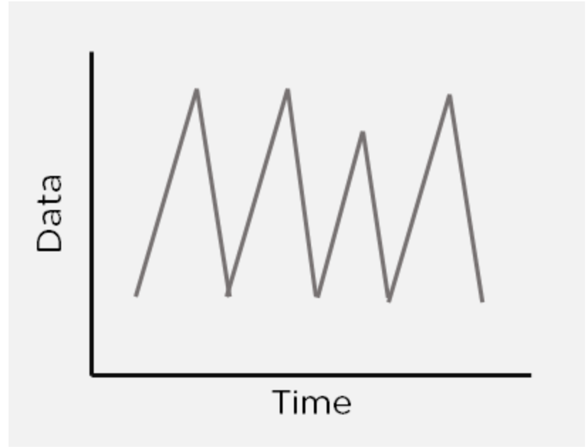
Time Series?
Time Series is a set of observations that are collected after regular intervals of time.

Slide 7
Time Series Components

Slide 8
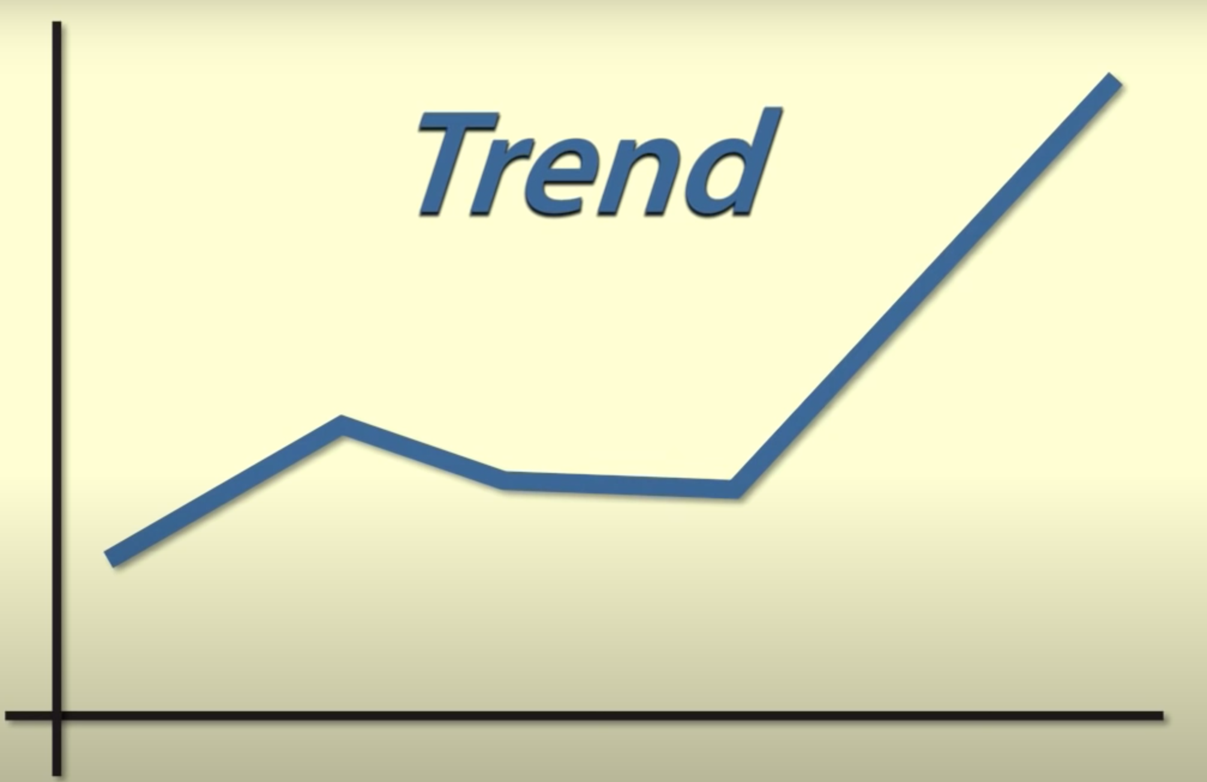
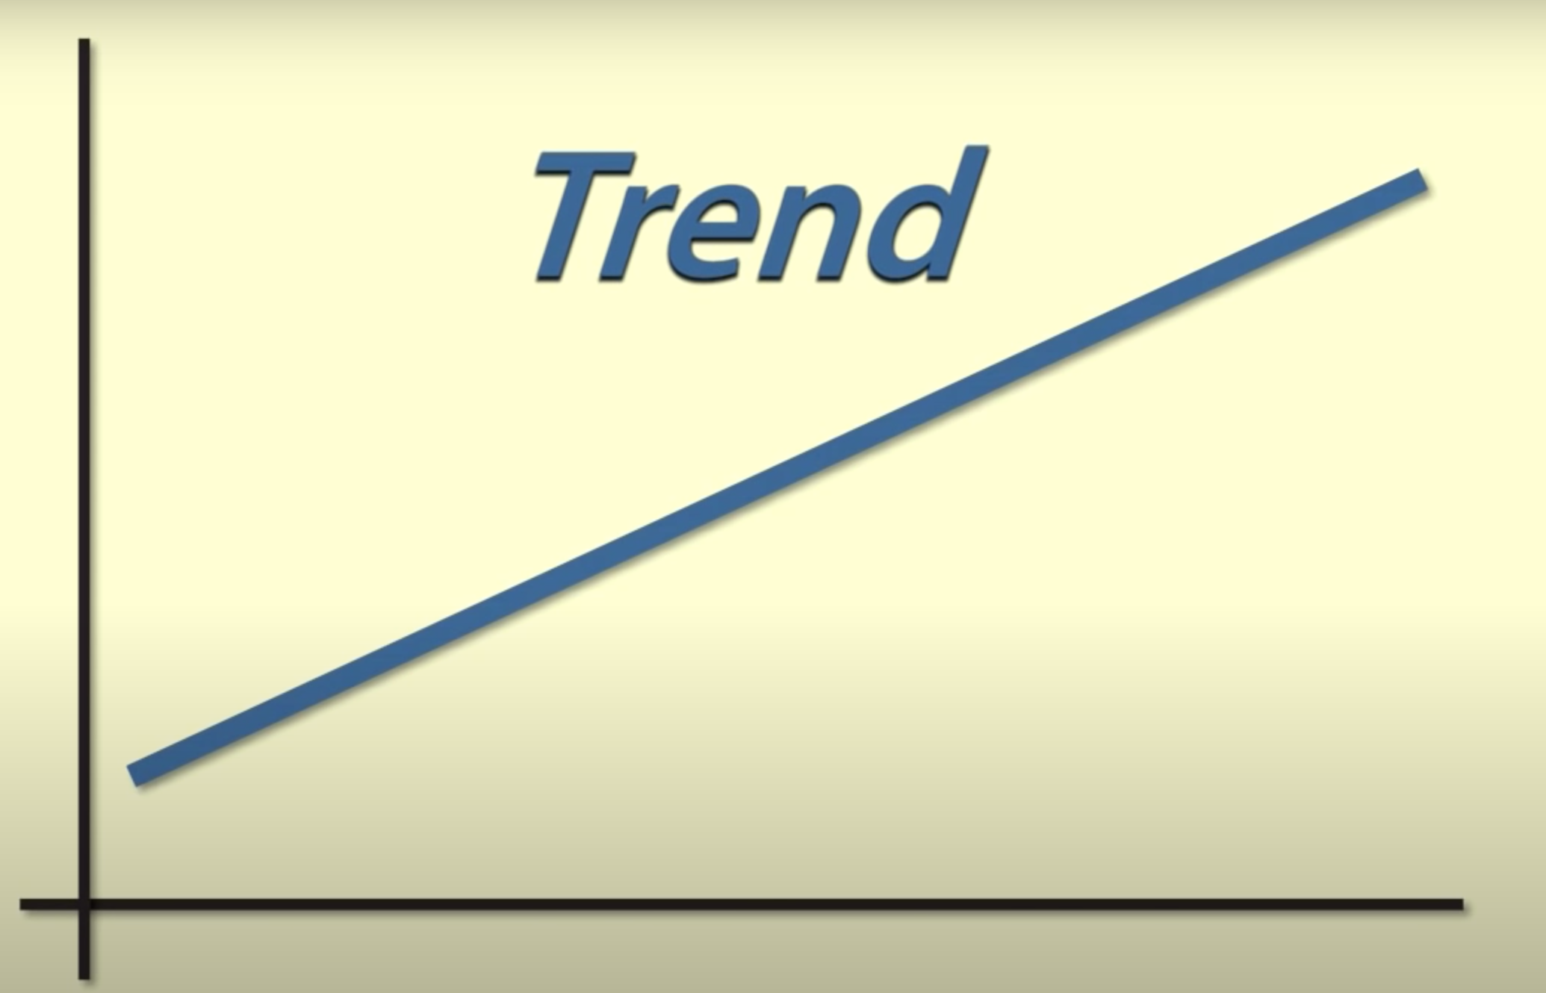
Trend
The overall long direction of the series.

Slide 9
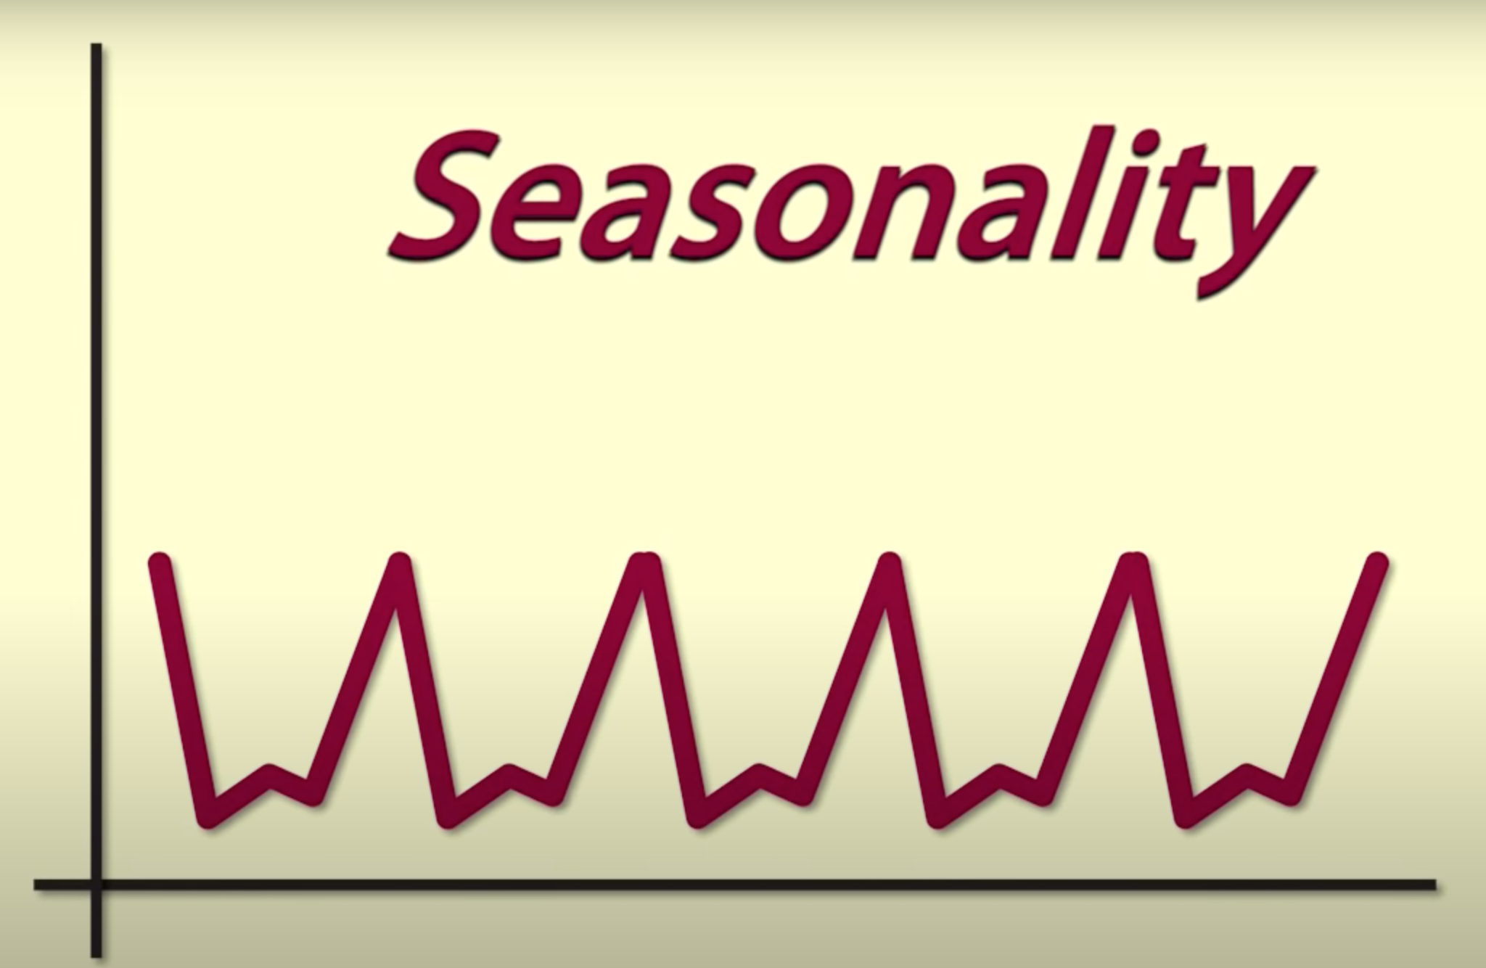
Seasonality
Occurrs when there is repeated behaviour in the data which occures at regular time interval.

Slide 10
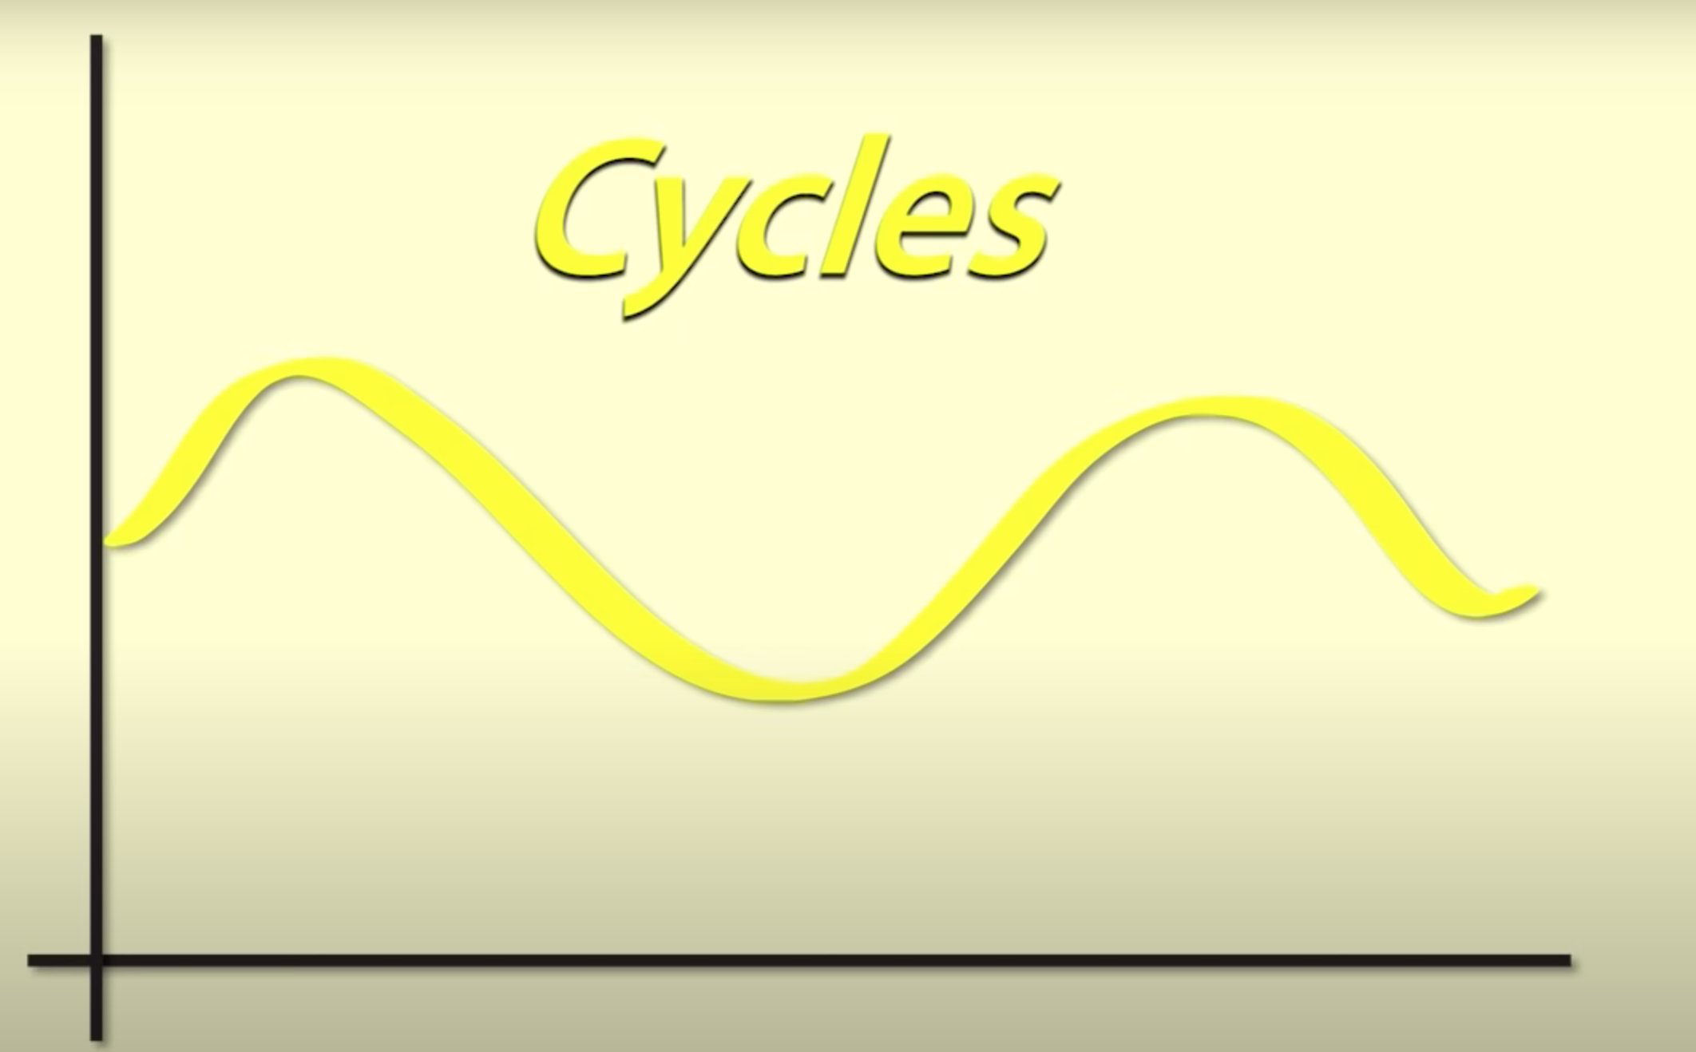
Cycles
Occurrs when series foollows an up-and-down pattern that is not seasonal.
More difficult to detect that seaasonality.

Slide 11
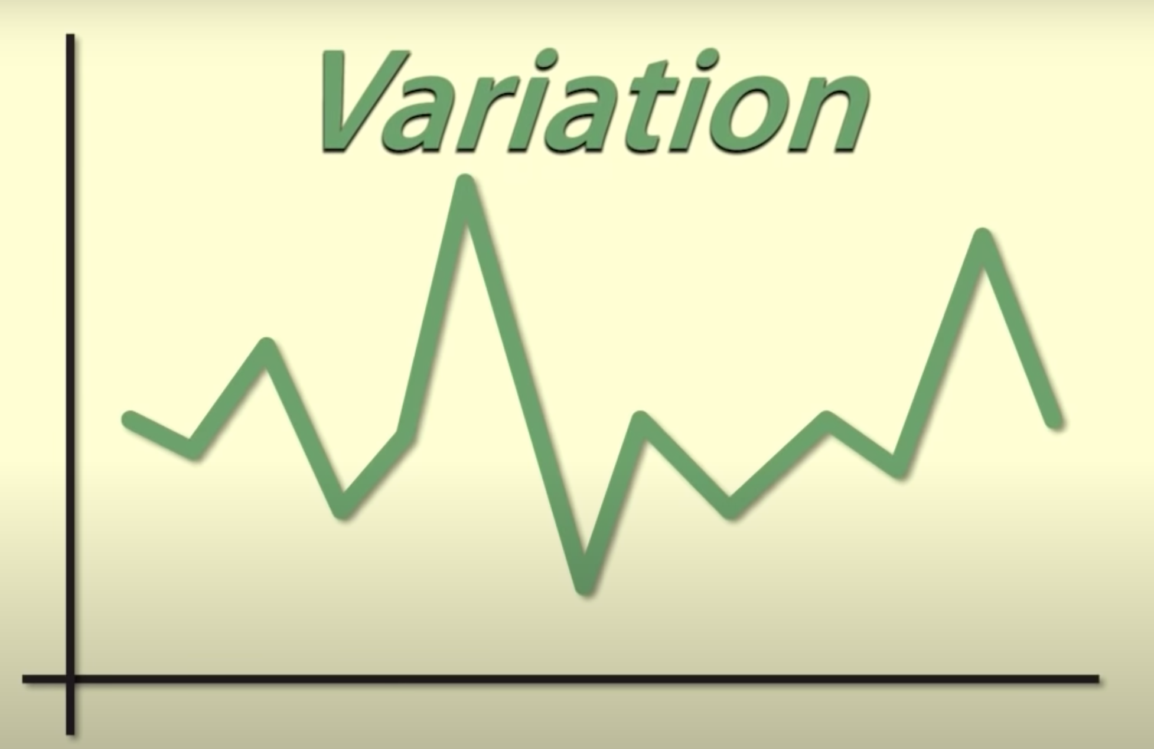
Random Variation
Fluctuations that are unforeseen, uncontrollable, unpredictable.

Slide 12
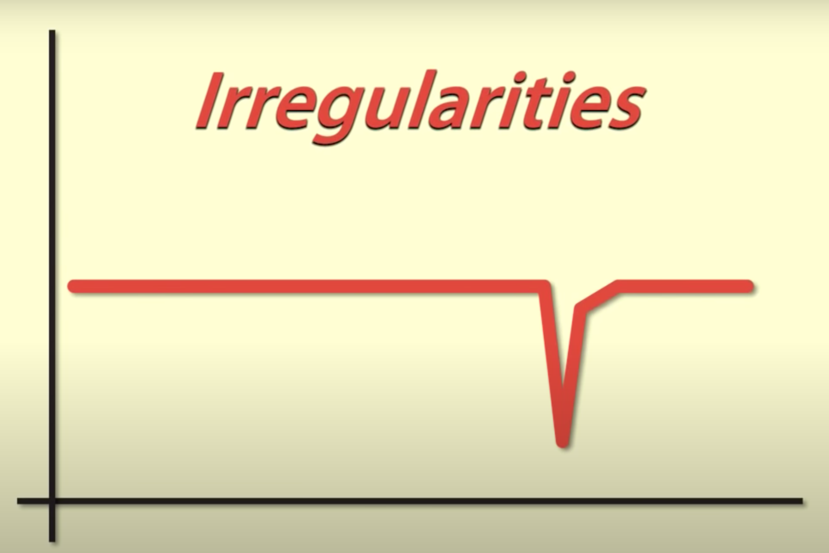
Irregularities
A strange jumps or drops in time series.

Slide 13
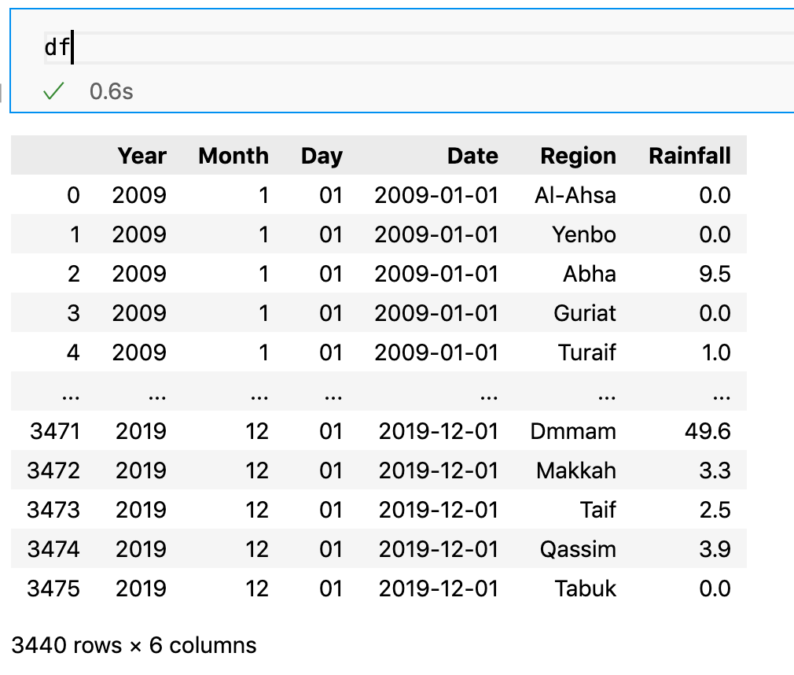
Dataset
Afte cleaning the data, it contains of 3440 observation and 6 features.

Slide 14
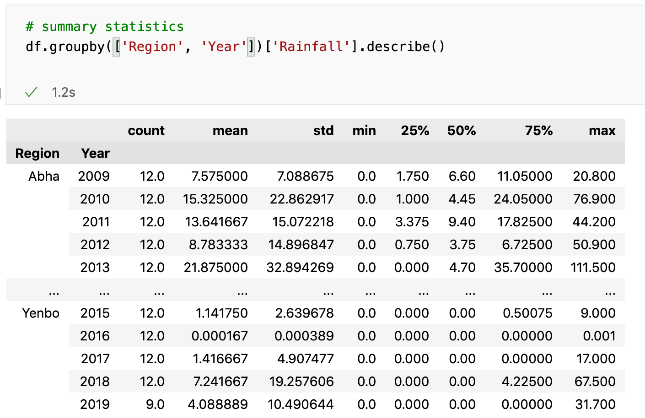
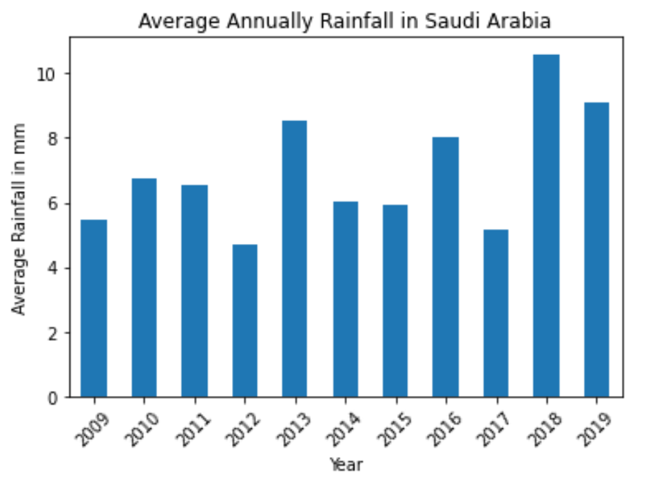
Exploratory Data Analysis

Slide 15
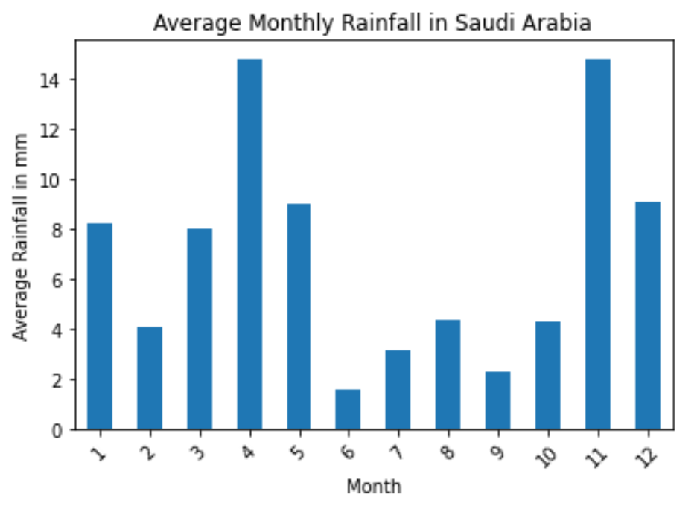
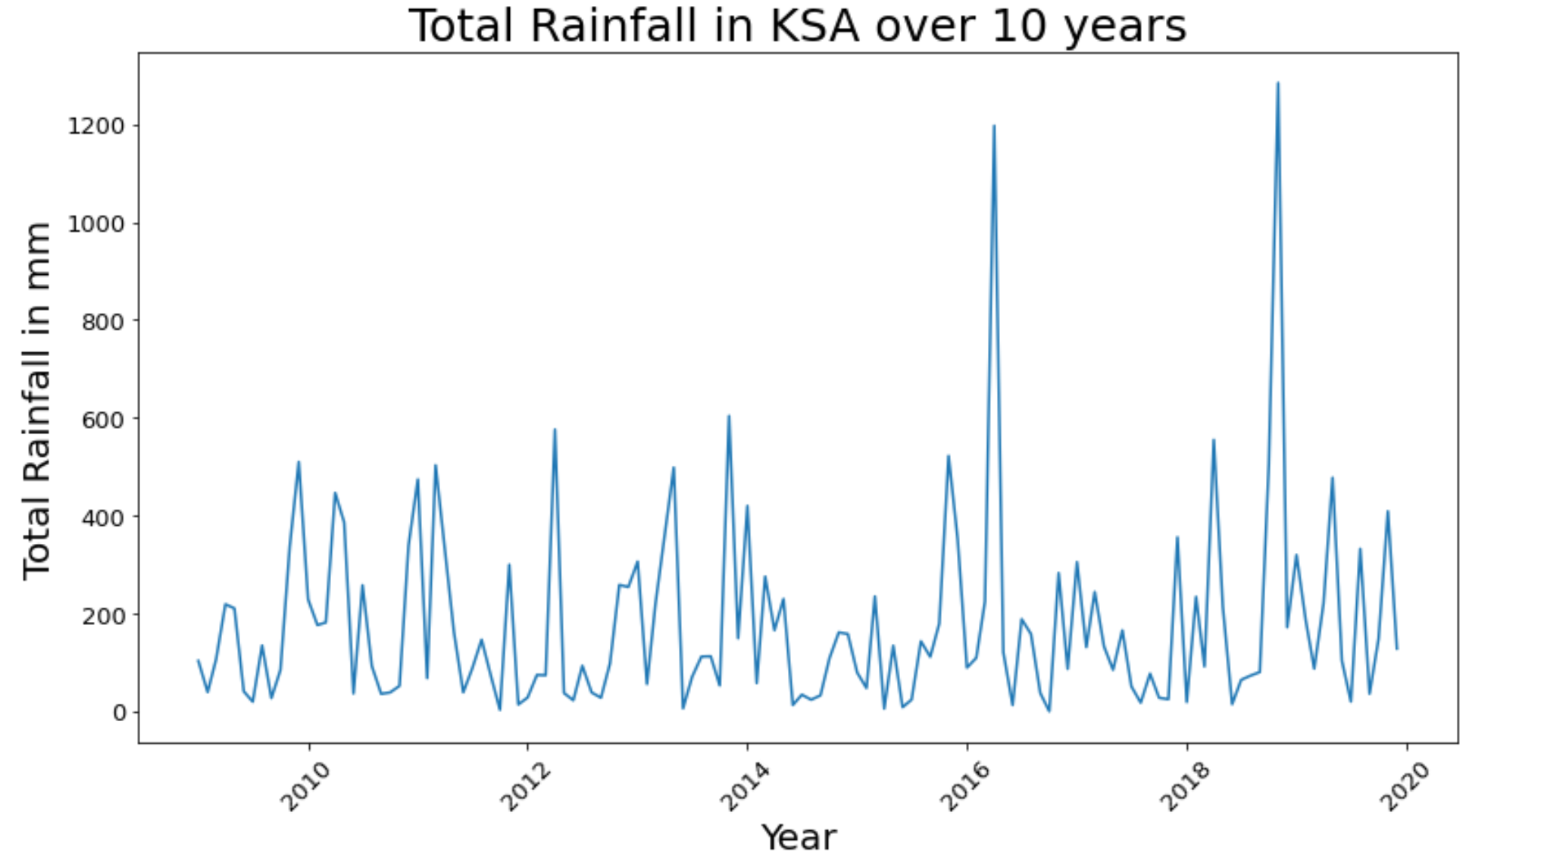
Exploratory Data Analysis (Cont.)

Slide 16
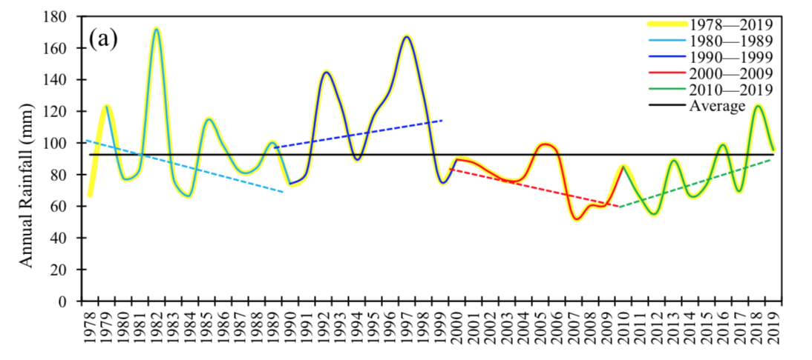
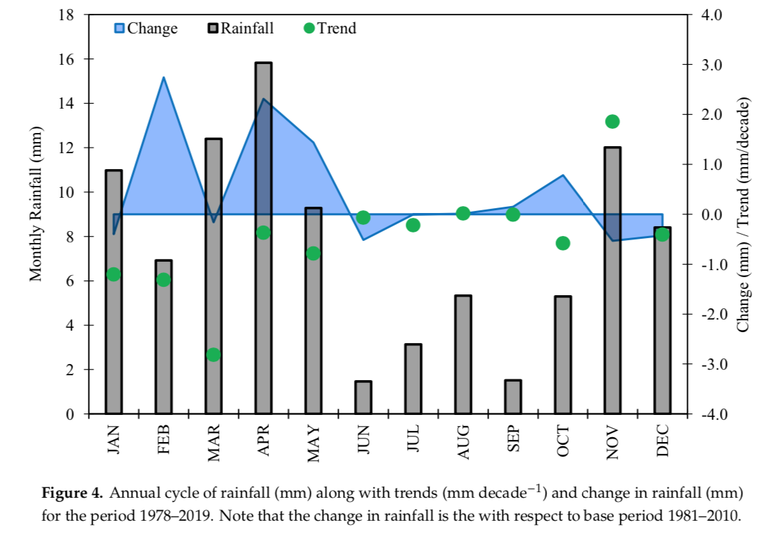
Trends*
*These figures are taken from other source [2].

Slide 17
Challenges
Data Availability
Time Limit
Climate Change

Slide 18

Future Work & Suggestion

Slide 19
Conclusion & Take-home Message
In-depth analysis of weather extreme records is necessary for developing policies linked with future planning for the water and agriculture sectors in the country.
More importantly, prediction of extreme rainfall will be helpful for preparing for the appropriate mitigation measures and to provide disaster resilience.

Slide 20
References
[1] Statistical Yearbook of 2019 | Issue Number: 55
[2] Almazroui, M. Rainfall Trends and Extremes in Saudi Arabia in Recent Decades. Atmosphere 2020, 11, 964. https://doi.org/10.3390/atmos11090964
[3] Total Rainfall by Region Station — KAPSARC Data Portal
Note: These are major references; please check out Notion Page for the list of all valuable resources used.

Slide 21





Professor Rick Scavetta
TA Lujain Felemban

Slide 22
Q & A

